Slide 1
Software Security
This lecture slide is mainly based on the power point slides by Professor Lawrie Brown, Dr. Junjie Zhang.

Slide 2

A Motivating Example
Break into a system or escalate your privilege

Slide 3
Two General Approaches
Identify the credential to break in
Weak password
Brute force
Social engineering
……
Compromise the program vulnerabilities
Incomplete mediation
Timing attacks
Buffer overflow
……
Notes:
Give an example of Tuna logs
and an example of URL request with injection attacks

Slide 4
Incomplete Mediation
A program fails to perform “sanity checks” on data.
An Example:
A program that accepts a filename, and outputs its content to a student.
void main(int argc, char ** argv) {
char buf[1024];
char* filename = get_str_from_socket();
sprintf(buf,”cat %s”,filename);
output_socket(system (“buf”));
}
%telnet server
homework1.txt
Question1
….
%telnet server
homework1.txt; rm ./*
Question1…..
(all files are deleted)
Notes:
The sprintf() function formats an output string into a character array buf.
System() invoke a shell to execute the specified command string:
Sprintf() stores the formatted string into a character buffer (an array of characters) provided by the user.
int system(const char *command);
Functionality: Executing Shell Commands: When command is a non-NULL string, system() passes this string to the operating system's command interpreter (e.g., sh on Unix-like systems, CMD.exe on Windows). The interpreter then executes the command as if it were typed directly into the shell.

Slide 5

Buffer Overflow
A Buffer Overflow is an anomaly where data is stored beyond the boundary of a fixed-length buffer.
Notes:
The overwritten data may include:
Other buffers or variables => incorrect computation
Program control information => program corruption or compromise.
Most common in C/C++ languages

Slide 6
Buffer Overflow
Stack Overflow
Heap Overflow

Slide 7
Buffer Overflow
Program V.S. Process
Program
A file
Static instructions
Static data
Process
An instance of a program
Loaded into the memory
Executing and dynamic

Slide 8
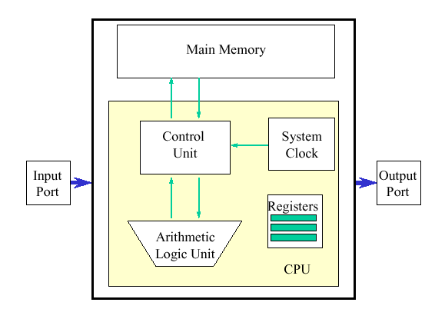
Program V.S. Process
Source Code
(.c, .cpp, .java….)
Compile, Link
Program
Executable
(EXE, ELF….)
Load
Process
Process

Slide 9
Process Memory Organization
Lower Mem Addr
OS Kernel
Text
Text:
Instructions
Read-only
Data
Data:
Static variables
Process
Heap
Stack
Stack:
Local variables
Return address
Each function is corresponding to one stack frame
Called: the stack frame is assigned
Returned: the stack frame is destroyed
Higher Mem Addr

Slide 10
Stack: A high-level Overview
when A() is called
B’s Stack Frame
void D(){
// do sth
}
void C(){
//do sth
}
void B(){
Int a = 2;
C();
D(); }
void A(){
int a =1;
B(); }
void main()
{
A();
}
Activation record
A’s Stack Frame
A’s Stack Frame
…..
…..
C’s Stack Frame
D’s Stack Frame
B’s Stack Frame
B’s Stack Frame
A’s Stack Frame
A’s Stack Frame
…..
…..
B’s Stack Frame
Returned from B()
A’s Stack Frame
A’s Stack Frame
…..
…..

Slide 11
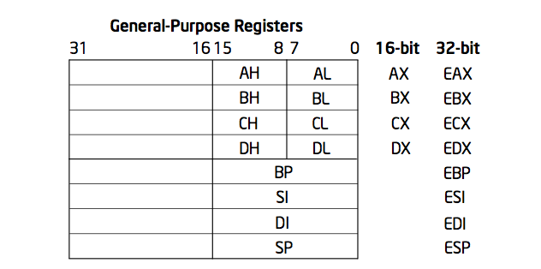
Registers for work space, x86
8, 16, and 32, 64 bit versions
By convention some registers for special purposes
Example: ADD EAX, 10
Other instructions: SUB, AND, etc.

Slide 12
Important Registers
EIP: the next address of current executed instruction (what is the next instruction the CPU needs to execute next?)
EBP: the address for the bottom of the current stack frame
ESP: the address for the top of the current stack frame
B’s Stack Frame
ESP
CPU
A’s EBP Value
EIP
EBP
A’s Stack Frame
…..
Text
Stack

Slide 13
BOF - An Example
main:
XXX
YYY # instrs for printf
#include <string.h>
int main (int argc, char **argv)
{
printf(“%s”, “CEG”);
foo(argv[1]);
printf(“%s”, “7900”)
}
void foo (char *bar)
{
char c[12];
strcpy (c, bar); //no bound
}
OS Kernel
push argv[1]
call foo #EIP will be pushed
Text
ZZZ
KKK # instrs for printf
Data
foo:
push EBP
mov ESP, EBP
sub 12 ESP #Allocate buffer
copy data
mov EBP ESP
pop EBP
ret
Heap
Stack
Source code in C
The executable illustrated
using assembly code
Memory layout
Notes:
Ask students which instructions will affect the stack?
: exec( “/bin/sh” )

Slide 14
BOF - An Example
#include <string.h>
int main (int argc, char **argv)
{
printf(“%s”, “CEG”);
foo(argv[1]);
printf(“%s”, “7900”)
}
void foo (char *bar)
{
char c[12];
strcpy (c, bar);
}
XXX
YYY # instrs for printf
push argv[1]
call foo #EIP will be pushed
pop
adr1
ZZZ
KKK #instrs for printf
foo:
push EBP
mov ESP, EBP
sub 12 ESP #Allocate buffer
copy data
mov EBP ESP
pop EBP
ret
main func’s
frame
ESP
EBP
Notes:
Ret: picks up the EIP stored in the stack and then execute
After ‘gcc –S –o stack.s stack.c’
See notes below

Slide 15
BOF - An Example
#include <string.h>
int main (int argc, char **argv)
{
printf(“%s”, “CEG”);
foo(argv[1]);
printf(“%s”, “7900”)
}
void foo (char *bar)
{
char c[12];
strcpy (c, bar);
}
XXX
YYY # instrs for printf
c[0]
ESP
push argv[1]
call foo #EIP will be pushed
pop
c[1]
Buffer for
12 chars
adr1
ZZZ
KKK #instrs for printf
c[11]
EBP
EBP
foo:
push EBP
mov ESP, EBP
sub 12 ESP #Allocate buffer
copy data
mov EBP ESP
pop EBP
ret
EIP(adr1)
argv[1]
main func’s
frame
Notes:
Ret: picks up the EIP stored in the stack and then execute
After ‘gcc –S –o stack.s stack.c’
See notes below

Slide 16
BOF - An Example
#include <string.h>
int main (int argc, char **argv)
{
printf(“%s”, “CEG”);
foo(argv[1]);
printf(“%s”, “7900”)
}
void foo (char *bar)
{
char c[12];
strcpy (c, bar);
}
./test abcdef87654
XXX
YYY # instrs for printf
‘a’
ESP
push argv[1]
call foo #EIP will be pushed
pop
‘b’
Buffer for
12 chars
adr1
ZZZ
KKK #instrs for printf
‘\0’
EBP
EBP
foo:
push EBP
mov ESP, EBP
sub 12 ESP #Allocate buffer
copy data
mov EBP ESP
pop EBP
ret
EIP(adr1)
argv[1]
main func’s
frame
argc is the number of argument strings, and it is greater than or equal to 1.
Argv is an array of pointers to character strings (c strings)
Argv[argc] contains a NULL pointer
Notes:
Ret: picks up the EIP stored in the stack and then execute
After ‘gcc –S –o stack.s stack.c’
See notes below

Slide 17
BOF - An Example
#include <string.h>
int main (int argc, char **argv)
{
printf(“%s”, “CEG”);
foo(argv[1]);
printf(“%s”, “7900”)
}
void foo (char *bar)
{
char c[12];
strcpy (c, bar);
}
./test abcdef1234876543
XXX
YYY # instrs for printf
‘a’
ESP
push argv[1]
call foo #EIP will be pushed
pop
‘b’
Buffer for
12 chars
adr1
ZZZ
KKK #instrs for printf
‘4’
‘3’
EBP
EBP
foo:
push EBP
mov ESP, EBP
sub 12 ESP #Allocate buffer
copy data
mov EBP ESP
pop EBP
ret
‘\0’
EIP(adr1)
argv[1]
main func’s
frame
Notes:
Ret: picks up the EIP stored in the stack and then execute
After ‘gcc –S –o stack.s stack.c’
See notes below

Slide 18
BOF - An Example
#include <string.h>
int main (int argc, char **argv)
{
printf(“%s”, “CEG”);
foo(argv[1]);
printf(“%s”, “7900”)
}
void foo (char *bar)
{
char c[12];
strcpy (c, bar);
}
./test abcdef1234876543
XXX
YYY # instrs for printf
‘a’
push argv[1]
call foo #EIP will be pushed
pop
‘b’
Buffer for
12 chars
adr1
ZZZ
KKK #instrs for printf
‘4’
‘3’
EBP
foo:
push EBP
mov ESP, EBP
sub 12 ESP #Allocate buffer
copy data
mov EBP ESP
pop EBP
ret
‘\0’
EIP(adr1)
ESP
argv[1]
main func’s
frame
Faults
Ox0000
Notes:
Ret: picks up the EIP stored in the stack and then execute
After ‘gcc –S –o stack.s stack.c’
See notes below

Slide 19
BOF - An Example
#include <string.h>
int main (int argc, char **argv)
{
printf(“%s”, “CEG”);
foo(argv[1]);
printf(“%s”, “7900”)
}
void foo (char *bar)
{
char c[12];
strcpy (c, bar);
}
./test 0xFF223……..
exec( “/bin/sh”)
XXX
YYY # instrs for printf
0xABCD
Malicious
Instructions
(shellcode)
push argv[1]
call foo #EIP will be pushed
pop
Buffer for
12 chars
adr1
ZZZ
KKK #instrs for printf
EBP
foo:
push EBP
mov ESP, EBP
sub 12 ESP #Allocate buffer
copy data
mov EBP ESP
pop EBP
ret
EIP(adr1)
0xABCD
argv[1]
Previous func’s
frame
ESP
EBP
Notes:
exec( “/bin/sh” )
After ‘gcc –S –o stack.s stack.c’
See notes below

Slide 20
BOF - An Example
#include <string.h>
int main (int argc, char **argv)
{
printf(“%s”, “CEG”);
foo(argv[1]);
printf(“%s”, “7900”)
}
void foo (char *bar)
{
char c[12];
strcpy (c, bar);
}
Pad shellcode with NOPs.
./test 0xFF223……..
XXX
YYY # instrs for printf
0xABCD
Malicious
Instructions
(shellcode)
push argv[1]
call foo #EIP will be pushed
pop
Buffer for
12 chars
adr1
ZZZ
KKK #instrs for printf
EBP
foo:
push EBP
mov ESP, EBP
sub 12 ESP #Allocate buffer
copy data
mov EBP ESP
pop EBP
ret
EIP(adr1)
0xABCD
argv[1]
Previous func’s
frame
ESP
EBP
Notes:
After ‘gcc –S –o stack.s stack.c’
See notes below

Slide 21
Pad Shellcode with NOPs
NOP
NOP
…..
NOP
As long as the overwritten return address (EIP’) hits one of the NOP instructions, the shellcode will be executed.
Shellcode
EIP’
argv[1]
main func’s
frame

Slide 22
BOF
Problem: no boundary checking in strcpy().
Suppose *str is such that after strcpy stack looks like:
When foo() exits, the user will be given a shell !
Note: attack code runs in stack.
Higher
Address
buffer Ebp ret Code for P
Program P: exec( “/bin/sh” )
Notes:
Call esp;
return-to-libc attack;

Slide 23
Implementation
E.g., Using Intel PIN
http://nsl.cs.columbia.edu/projects/minestrone/isr/
Notes:
Fuzz testing or fuzzing is an automated software testing method that injects invalid, malformed, or unexpected inputs into a system to reveal software defects and vulnerabilities.
A fuzzing tool injects these inputs into the system and then monitors for exceptions such as crashes or information leakage.

Slide 24
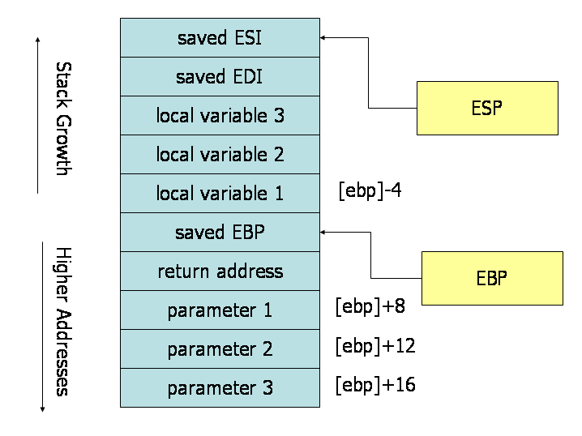
A snapshot of the stack frame
int foo (int arg1, int arg2, int arg3) ;
Note: In the stack frame for a function, the order and the location of the input parameters, and the local variables, will depend on the programming language and the compiler used, and the target machine Architecture.
Compiler: gcc
Language: c language
Machine architecture: intel processors
https://flint.cs.yale.edu/cs421/papers/x86-asm/asm.html

Slide 25
A snapshot of the stack frame: An Example
int foo(int a, int b, int c)
{
int x, y, z;
x = a + 5;
y = b - 3;
z = c * 2;
return 0;
}
Stack Frame Layout:
Lower address of memory
=============
z
y
x
EBP
EIP (return address)
a
b
c
=================
Higher address of memory
Compiler: gcc
Language: c language
Machine architecture: intel processors
Note: In the stack frame for a function, the order and the location of the input parameters, and the local variables, will depend on the programming language and the compiler used, and the target machine Architecture.
Notes:
gcc stack.c –S –o stack.s

Slide 26
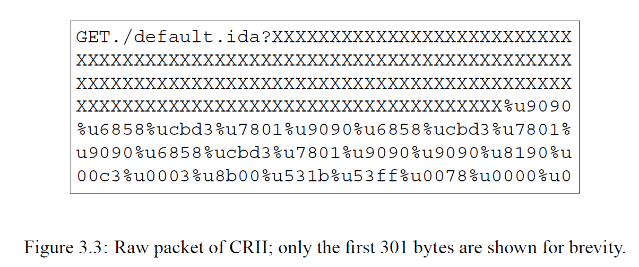

A BOF-Vulnerable HTTP Service
HTTP Request with BOF attack
Code Red II virus: buffer overflow in Microsoft’s Internet Information Services (IIS) 5.0
HTTP Server
(IP/Port = 80)
Notes:
Code Red virus: buffer overflow in Microsoft’s Internet Information Services (IIS) 5.0

Slide 27
BoF Incidents … Just a Sample!
1988: Morris worm
– took down Internet– Includes buffer overflow via gets() in fingerd
1998: University of Washington IMAP (mail) server
1999: RSA crypto reference implementation
Subverted PGP, OpenSSH, Apache’s ModSSL, etc.
2001: Code Red worm
buffer overflow in Microsoft’s Internet Information Services (IIS) 5.0
2003: SQL Slammer worm compromised machines running Microsoft SQL Server 2000
~2008: Twilight hack – unlocks Wii consoles
Creates an absurdly-long horse name for “The Legend of Zelda: Twilight Princess” that includes a program

Slide 28
Solutions
When Programming
Using security-enhanced APIs
When Compiling
Detecting bugs/vulnerabilities (automatically code auditing)
Instrumenting binaries
Adding boundaries
Adding flags to illustrate execution paths
When running
Interface-based detection
Taint-based detection
Moving target defense
Notes:
Adding boundaries by compiler: canary

Slide 29
Some unsafe C lib functions
strcpy (char *dest, const char *src)
strcat (char *dest, const char *src)
gets (char *s)
scanf ( const char *format, … )
sprintf (conts char *format, … )

Slide 30
Programming with Secure APIs

Slide 31
Off by one buffer overflow
Boundary Check
Sample code
func f(char *input) {
char buf[LEN];
if (strlen(input) <= LEN) {
strcpy(buf, input)
}
}

Slide 32
Preventing Buffer Overflow Attacks
Use type safe languages (Java, ML).
Use safe library functions
Static source code analysis.
Non-executable stack
Run time checking: StackGuard, Libsafe, SafeC, (Purify).
Address space layout randomization.
Instruction Set Randomization
Detection deviation of program behavior
Notes:
Type safe language, such as Java, (1) Java will do boundary check
(2) there is a tag to indicate if the data stored in the memory is data or instructions in the Java virtual machine.

Slide 33
Static source code analysis
Statically check source code to detect buffer overflows.
Berkeley: Wagner, et al. Test constraint violations.
Find lots of bugs, but not all.

Slide 34
Marking stack as non-execute
Basic stack exploit can be prevented by marking stack segment as non-executable.
Support in Windows SP2. Code patches exist for Linux, Solaris.
Problems:
Does not defend against `return-to-libc’ exploit.
Some apps need executable stack (e.g. LISP interpreters).
Does not block more general overflow exploits:
Overflow on heap, overflow func pointer.
Notes:
Overflow sets return-address to the address of the libc function;
Code gadgets.

Slide 35
Run time checking: StackGuard
StackGuard prevents changes to active return addresses by either detecting the change of the return address before the function returns, or by completely preventing the write to the return address.
StackGuard tests for stack integrity.
Embed “canaries” in stack frames and verify their integrity prior to function return.
Frame 2
Frame 1
Higher
Address
local
canary
Ebp
ret
args
local
canary
Ebp
ret
args
Notes:
StackGuard: gcc compiler patches

Slide 36
Canary Types
Random canary:
Choose random string at program startup.
Insert canary string into every stack frame.
Verify canary before returning from function.
To corrupt random canary, attacker must learn current random string.
Terminator canary: Canary = 0, newline, linefeed, EOF
String functions will not copy beyond terminator.
Hence, attacker cannot use string functions to corrupt stack.

Slide 37
StackGuard (Cont.)
StackGuard implemented as a GCC patch.
Program must be recompiled.
Minimal performance effects: 8% for Apache.
Newer version: PointGuard.
Protects function pointers and setjmp buffers by placing canaries next to them.
More noticeable performance effects.
Note: Canaries don’t offer fullproof protection.
Some stack smashing attacks can leave canaries untouched.
Preventing Return Address Changes With MemGuard

Slide 38
StackGuard (Cont.)
StackGuard implemented as a GCC patch.
Program must be recompiled.
Minimal performance effects: 8% for Apache.
Newer version: PointGuard.
Protects function pointers and setjmp buffers by placing canaries next to them.
More noticeable performance effects.
Note: Canaries don’t offer fullproof protection.
Some stack smashing attacks can leave canaries untouched.

Slide 39
Randomization: Motivations.
Buffer overflow and return-to-libc exploits need to know the (virtual) address to which pass control
Address of attack code in the buffer
Address of a standard kernel library routine
Same address is used on many machines
Slammer infected 75,000 MS-SQL servers using same code on every machine
Idea: introduce artificial diversity
Make stack addresses, addresses of library routines, etc. unpredictable and different from machine to machine
Notes:
Overflow sets return-address to the address of the libc function
Address space layout randomization (ASLR) proposes a defense against BOF attacks by shifting the starting addresses of a process’s text and data segments each time it is run.

Slide 40
Address Space Layout Randomization
Address space layout randomization (ASLR) proposes a defense against BOF attacks by shifting the starting addresses of a process’s text and data segments each time it is run.
Arranging the positions of key data areas randomly in a process' address space.
e.g., the base of the executable and position of libraries (libc), heap, and stack,
Effects: for return to libc, needs to know address of the key functions.
Attacks:
Repetitively guess randomized address
Spraying injected attack code
Vista has this enabled, software packages available for Linux and other UNIX variants
Notes:
Overflow sets return-address to the address of the libc function
Address space layout randomization (ASLR) proposes a defense against BOF attacks by shifting the starting addresses of a process’s text and data segments each time it is run.

Slide 41
Instruction Set Randomization
Instruction Set Randomization (ISR)
Each program has a different and secret instruction set
Use translator to randomize instructions at load-time
Attacker cannot execute its own code.
What constitutes instruction set depends on the environment.
for binary code, it is CPU instruction
for interpreted program, it depends on the interpreter
Notes:
Malicious code written in Apple instructions cannot be executed on an Intel machine.
Encryption the instructions with a key, and decrypt them before execution, XOR with the key.

Slide 42
Instruction Set Randomization
An implementation for x86 using the Bochs emulator
network intensive applications doesn’t have too much performance overhead
CPU intensive applications have one to two orders of slow-down
Not yet used in practice

Slide 43
Instruction Set Randomization
Injected Instruction
Injected Instruction
Instruction
Instruction
decrypt
KEY
CPU
CPU
XOR the instructions with the key
Notes:
Malicious code written in Apple instructions cannot be executed on an Intel machine.
XOR the instructions with the key

